Slide 1
Introduction to Probability and Statistics
Twelfth Edition
Robert J. Beaver • Barbara M. Beaver • William Mendenhall
Presentation designed and written by:
Barbara M. Beaver

Slide 2
Introduction to Probability and Statistics
Twelfth Edition
Chapter 3
Describing Bivariate Data
Some images © 2001-(current year) www.arttoday.com

Slide 3
Bivariate Data
When two variables are measured on a single experimental unit, the resulting data are called bivariate data.
You can describe each variable individually, and you can also explore the relationship between the two variables.
Bivariate data can be described with
  Graphs
  Numerical Measures

Slide 4
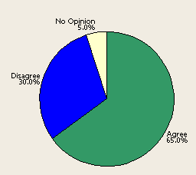
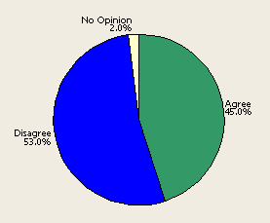
Graphs for Qualitative Variables
When at least one of the variables is qualitative, you can use comparative pie charts or bar charts.
Do you think that men and women are treated equally in the workplace?
Variable #1 =
Variable #2 =
Opinion
Gender
Men
Women

Slide 5
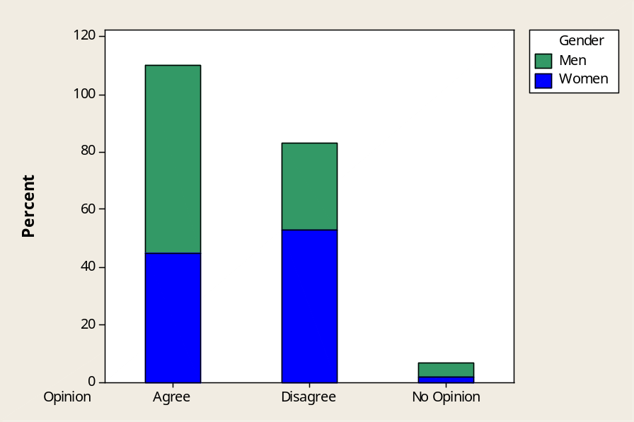
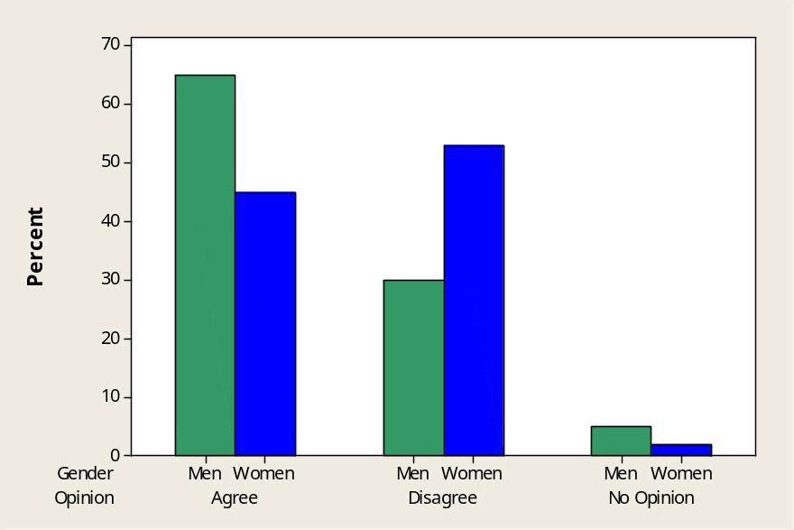
Comparative Bar Charts
Stacked Bar Chart
Side-by-Side Bar Chart
Describe the relationship between opinion and gender:
More women than men feel that they are not treated equally in the workplace..

Slide 6
Two Quantitative Variables
When both of the variables are quantitative, call one variable x and the other y. A single measurement is a pair of numbers (x, y) that can be plotted using a two-dimensional graph called a scatterplot.
y
(2, 5)
y = 5
x
x = 2

Slide 7
Describing the Scatterplot
What pattern or form do you see?
  Straight line upward or downward
  Curve or no pattern at all
How strong is the pattern?
  Strong or weak
Are there any unusual observations?
  Clusters or outliers

Slide 8
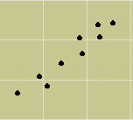
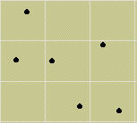
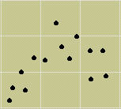
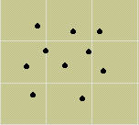
Examples
Positive linear - strong
Negative linear -weak
Curvilinear
No relationship

Slide 9
Numerical Measures for Two Quantitative Variables
Assume that the two variables x and y exhibit a linear pattern or form.
There are two numerical measures to describe
  The strength and direction of the relationship between x and y.
  The form of the relationship.

Slide 10
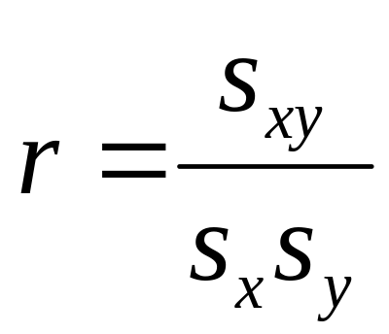
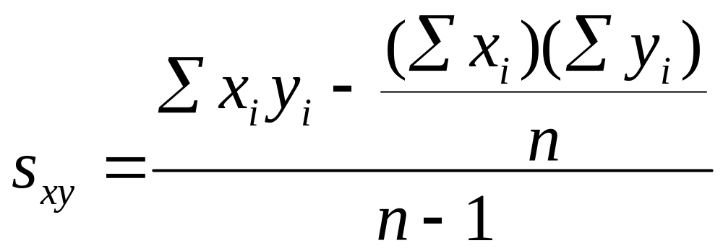
The Correlation Coefficient
The strength and direction of the relationship between x and y are measured using the correlation coefficient, r.
where
s_{x} = standard deviation of the x’s
s_{y} = standard deviation of the y’s

Slide 11

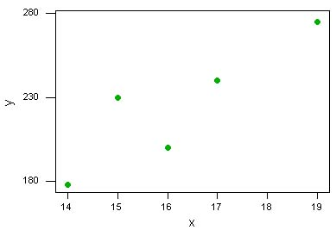
Example
Living area x and selling price y of 5 homes.
Residence | 1 | 2 | 3 | 4 | 5
x (thousand sq ft) | 14 | 15 | 17 | 19 | 16
y ($000) | 178 | 230 | 240 | 275 | 200
The scatterplot indicates a positive linear relationship.

Slide 12
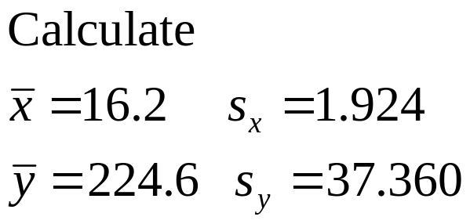
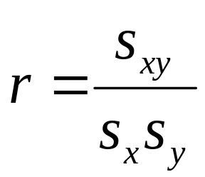

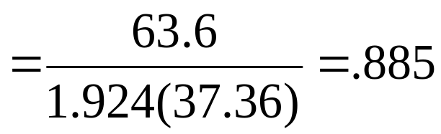
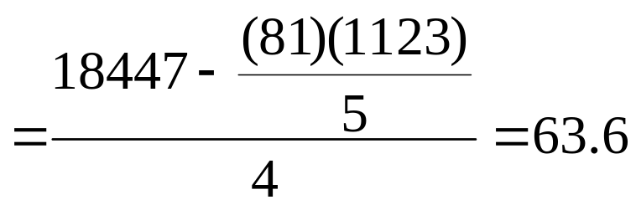
Example
x | y | xy
14 | 178 | 2492
15 | 230 | 3450
17 | 240 | 4080
19 | 275 | 5225
16 | 200 | 3200
81 | 1123 | 18447

Slide 13
Interpreting r
MY
APPLET
-1 ≤ r ≤ 1
r ≈ 0
r ≈ 1 or –1
r = 1 or –1
Sign of r indicates direction of the linear relationship.
Weak relationship; random scatter of points
Strong relationship; either positive or negative
All points fall exactly on a straight line.

Slide 14
The Regression Line
Sometimes x and y are related in a particular way—the value of y depends on the value of x.
  y = dependent variable
  x = independent variable
The form of the linear relationship between x and y can be described by fitting a line as best we can through the points. This is the regression line,
  y = a + bx.
  a = y-intercept of the line
  b = slope of the line
MY
APPLET

Slide 15
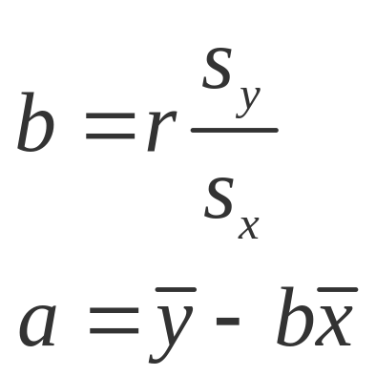
The Regression Line
To find the slope and y-intercept of the best fitting line, use:
The least squares
regression line is y = a + bx

Slide 16
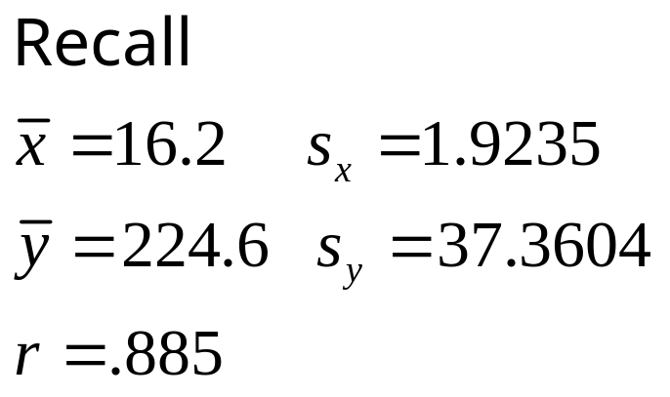
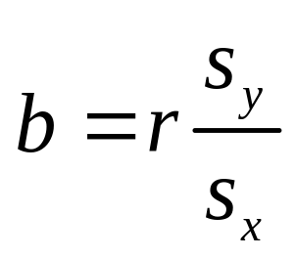
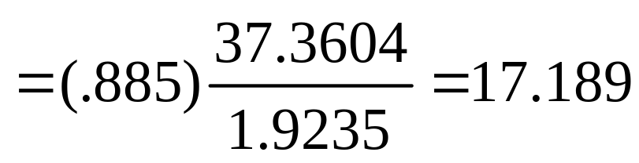
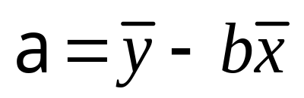
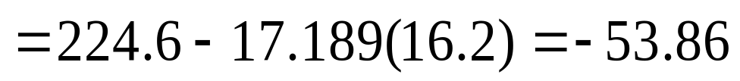
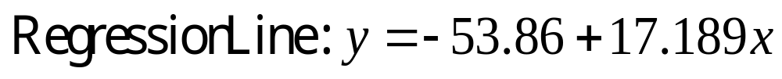
Example
x | y | xy
14 | 178 | 2492
15 | 230 | 3450
17 | 240 | 4080
19 | 275 | 5225
16 | 200 | 3200
81 | 1123 | 18447

Slide 17
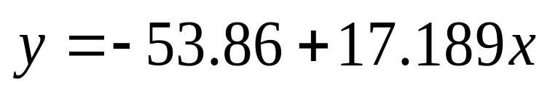
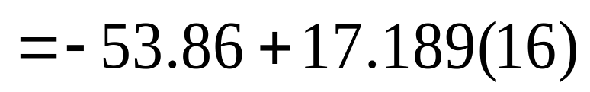
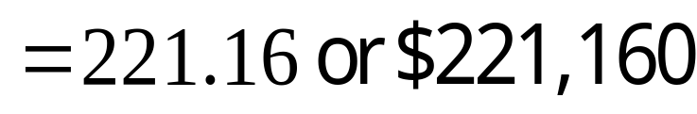
Example
Predict the selling price for another residence with 1600 square feet of living area.
Predict:

Slide 18
Key Concepts
I. Bivariate Data
1. Both qualitative and quantitative variables
2. Describing each variable separately
3. Describing the relationship between the variables
II. Describing Two Qualitative Variables
1. Side-by-Side pie charts
2. Comparative line charts
3. Comparative bar charts
  Side-by-Side
  Stacked
4. Relative frequencies to describe the relationship between the two variables.

Slide 19
Key Concepts
III. Describing Two Quantitative Variables
1. Scatterplots
  Linear or nonlinear pattern
  Strength of relationship
  Unusual observations; clusters and outliers
2. Covariance and correlation coefficient
3. The best fitting line
  Calculating the slope and y-intercept
  Graphing the line
  Using the line for prediction

